Slide 1

CS 533 INTRO TO DATA SCIENCE
Michael Ekstrand

Slide 2
SOURCES AND BIAS

Slide 3

Learning Outcomes
Understand what bias means
Identify sources of bias in a observations of a variable
Photo by MILKOVÍ on Unsplash

Slide 4
Estimating
Goal: estimate the value of a parameter

Slide 5
Data Pipeline
Things
Phenomena / Experiment
“Raw” Data
Answers
Inferences
Data Set

Slide 6
Estimating
Goal: estimate the value of a parameter
True value in the world or population
Estimated by a statistic
Example: estimate approval of our company
Parameter: net approval (% of people who have a positive opinion)
Statistic: % of a sample of people who say they have a positive opinion
Goal: statistic is approximately parameter

Slide 7
A Few Sources of Bias
Population
Selection bias
Some people more likely to be contacted
Response bias
Some people are more likely to respond
Measurement bias
Measurement skews one way or another
Contacted
Responds
Opinion

Slide 8
Non-Uniform Bias
Bias may not affect all groups equally
Under-representation
Over-representation
Measurement skews
E.g. standardized test scores reflect socio-economic status

Slide 9
Documenting
Clearly and fully document data collection process!
See Datasheets for Datasets reading
Enables further and future analysis of collection process!
Helps future users assess if biases affect their problem

Slide 10
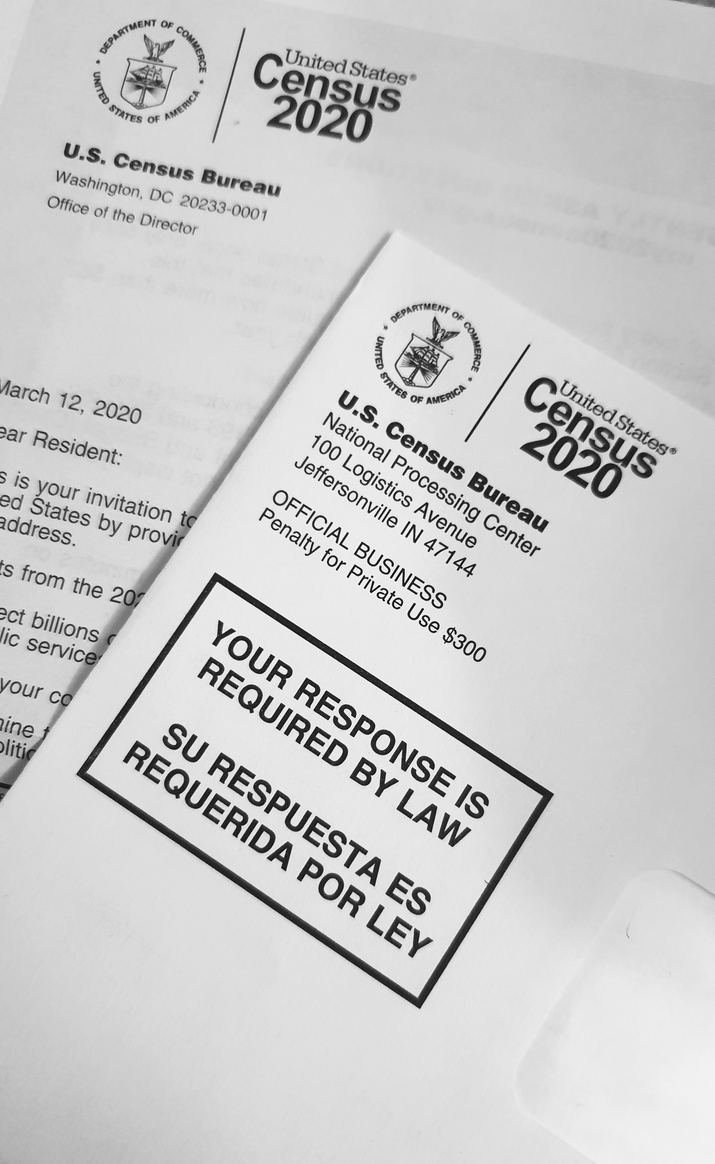
Wrapping Up
Goal is for data to accurately reflect population, and statistics to approximate parameters.
Various sources of bias can impede this.
Photo by Enayet Raheem on Unsplash

